Slide 1
Database Principles and Application
DATSYS – PRELIM

Slide 2
Database

Slide 3
What is a database?
A structured collection of related data
designed to manage large bodies of information
Examples
Address book
Telephone directory
Time table

Slide 4
Three Main Purposes of a Database
Organize
Store
Retrieve
(NOTE: Retrieval is the most important)

Slide 5
Database Systems VS File System
File processing system
Supported by conventional operating system
The system stores permanent records
Database system
Collection of interrelated files
Data abstraction

Slide 6
Functionalities of a Database for Efficient Processing

Slide 7
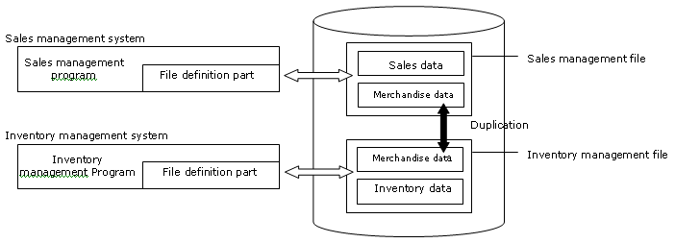
File-Based System

Slide 8
What is a File-Based System?
Method of storing and organizing computer files
Organizes these files into a database for
Storage
Organization
Manipulation and
Retrieval by Computer’s Operating System

Slide 9
Major Disadvantages of File-Based Systems
Data redundancy and inconsistency
Difficulty in accessing data
Integrity problems
Data isolation
Security problems

Slide 10
Function of a Database
Eliminate duplication of data items
To maintain strict consistency of the file contents
To make the programs independent of files
File security

Slide 11
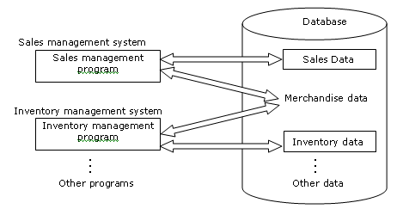
Database System

Slide 12
Data Model

Slide 13
What is a Data Model?
An abstract model
Describes how data are represented and accessed
Formally define data elements
Relationships among data elements

Slide 14
Data Model
Data model
Real world
Database

Slide 15
Conceptual Data Model
A map of concepts and their relationship
Describes the semantic of an organization
Represent a series of assertions
Describes the significance to organization; entity classes, attributes and relationships

Slide 16
Creation Process of a Data Model
First, target data independently
Conceptual model
Next, convert conceptual into data model
Logical model
Data model
Targeted real
world
Conceptual
model
Logical model
Independent of DBMS
DBMS dependent
Notes:
Conceptual model Real-world entities and relationships | High-level, abstract Relational Data Model ER Diagram or ER Model Object-Oriented Data Model: This model represents data as objects with attributes and methods. It's often used in object-oriented programming and databases.
Entity-Attribute-Value (EAV) Model: This flexible model stores data in a dynamic structure, allowing for unstructured data. It's often used for data warehousing and analytics. Logical Model
Data structures and relationships | Detailed
Relational Schema or Database Schema Hierarchical Data Model
Network Data Model

Slide 17
Hierarchical Data Model
Three elements of hierarchical data model
Root: highest-level data, data retrieval
Node: middle-level data, parent and child
Leaf: terminal data, end node

Slide 18
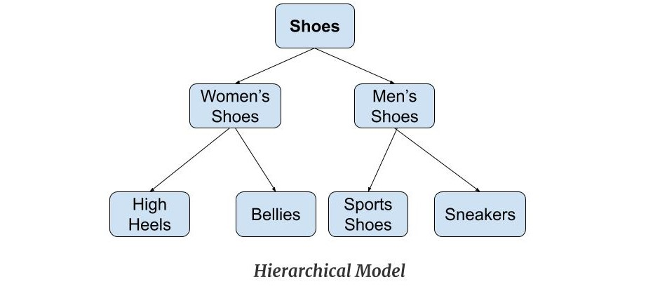

Slide 19
Network Data Model
Organizes data using two fundamental constructs:
Records
Contains fields
Sets
Define one-to-one relationships between records
One owner, many members

Slide 20
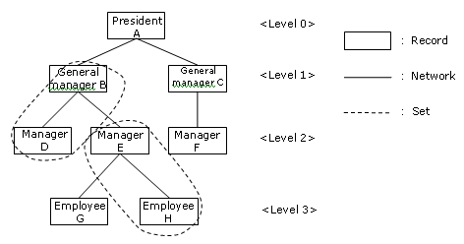
Structure of a Network Data Model

Slide 21
Relational Data Model
First-order predicate logic
Collections of predicates over a finite set
Describing constraints on possible value, combination of values

Slide 22
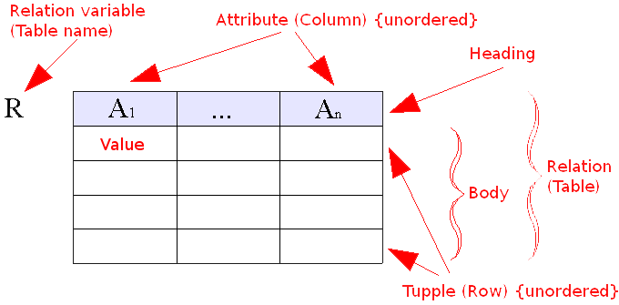
Relational Data Model

